Slide 1
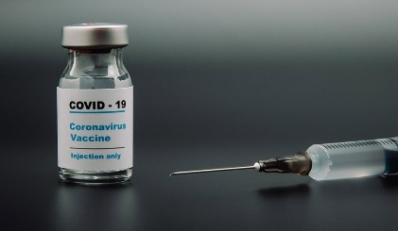

BIOINFORMATICS
INTERNATIONAL UNIVERSITY OF BUSINESS AGRICULTURE AND TECHNOLOGY

Slide 2


Presentation By,
Shariful Islam Atik, ID 20303037
Riana Azad, ID 20303033
We are from………..
Section E
Fall Semester 2020
Department of Computer Science and Engineering
INTERNATIONAL UNIVERSITY OF BUSINESS AGRICULTUE AND TECHNOLOGY
Special Thanks to…
MD. ABDUL KARIM
FACULTY MECHANICAL ENGINEERING
COURSE INSTRUCTOR
ART 102 EDUCATIONAL PLANNING

Slide 3

We are going to talk about…
Objectives
What is Bioinformatics?
How it works?
Why do we need Bioinformatics?
Why is it important?
Task of informaticians
Skills required
How can we(CS Students) take active part to improve this field?
Steps in a typical Bioinformatic experiment
Goals
Summary

Slide 4

Objectives
Clear idea about Bioinformatics
Understand the relationship between Bioinformatics and other fields
Understand why and how the fields are interconnected
Understand why do we need Bioinformatics
Have a clear idea how bioinformaticians work
We will know which skills are required
Understand how a typical experiment works
Will know how should we prepare ourselves to get involved in this field

Slide 5
THINK…
How the drugs are invented to work on human body?
What microorganisms live within us?
?
What part of the world did my ancestors live?
Why some people are kind in nature and why others aren’t?
Best flu vaccine to prepare for noble flu virus?

Slide 6
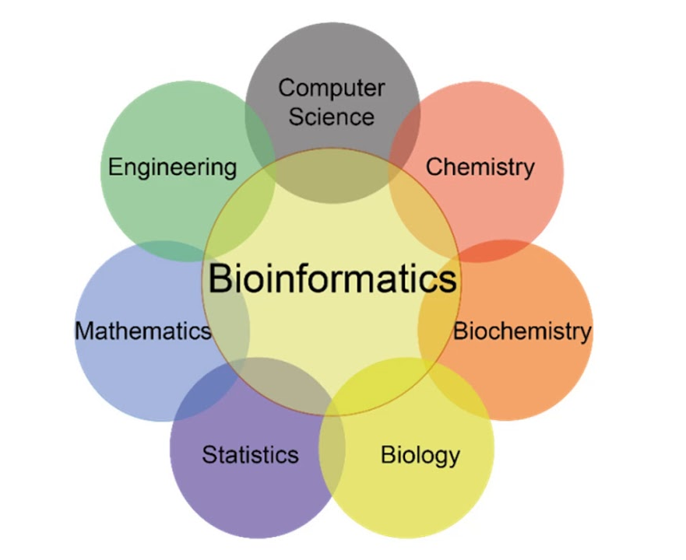
What is Bioinformatics?
Bioinformatics is the application of techniques from Computer science to the problems of Biology.
Bio
Biology
Informatics
Information

Slide 7
What Wikipedia says,
Bioinformatics is an interdisciplinary field that develops methods and software tools for understanding biological data, in particular when the data sets are big and complex.
As an interdisciplinary field of science, bioinformatics combines biology, computer science, information engineering, mathematics and statistics to analyze and interpret the biological data.

Slide 8
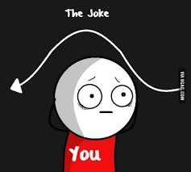
Information?
RNA?
Data Sets?
Big and Complex Data?
DNA?

Slide 9
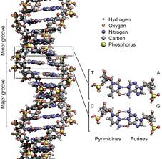
In few words…
The information can be the genetic code contained in a DNA which is a recipe book or a blueprint of our body telling it how to make everything from muscles to hairs and toes.

Slide 10
THINK…
How the drugs are invented to work on human body?
What microorganisms live within us?
?
What part of the world did my ancestors live?
Why some people are kind in nature and why others aren’t?
Best flu vaccine to prepare for noble flu virus?

Slide 11
The answer is….
Structural proteomics Data
Collection of Huge amount of Data
Huge Omics Data sets
High-throughput sequencing data
Huge Amount of Data?
DNA Data from Genomes
RNA Data from Transcriptomes

Slide 12
What do we mean by Huge Data set?
A typical whole genome-dataset requires 100 GB
To consume this much memory with text messages we would have to save all messages for 14700 years which is more than 565 millions of text messages, each text of 190 bytes.

Slide 13
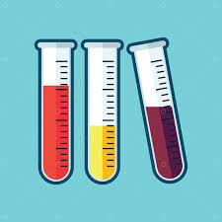


In short…
ACGCGAACG
CCGAGAACG
ALGORITHM
RESULT

Slide 14
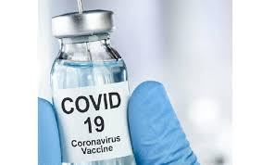
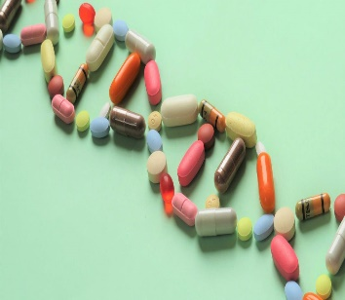
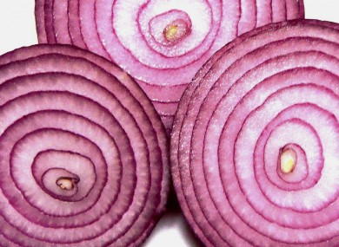
Why Bioinformatics?
Want to get rid of lockdown?
Falling sick?- Need drugs?
Onions that don’t make you cry?

Slide 15
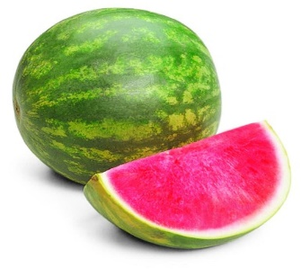
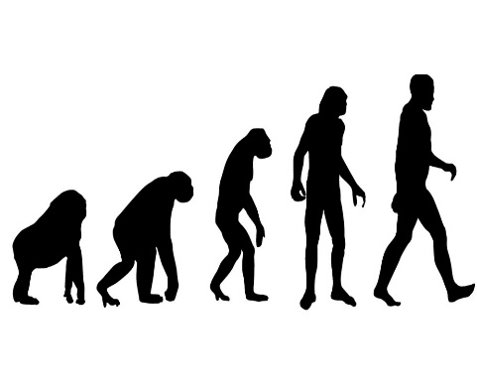
Why Bioinformatics?
Seedless Watermelon?
Interested to know about evolution?

Slide 16
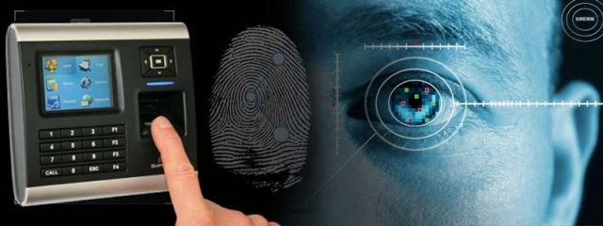
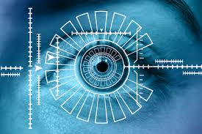
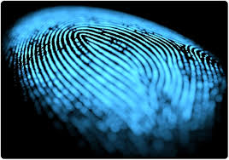
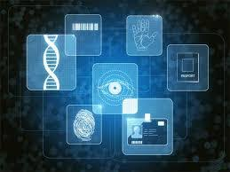
Application in Biometrics
PRESENT
Retina Scan
Finger Print
Facial Recognition
FUTURE
DNA Recognition

Slide 17

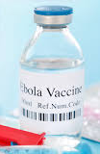
Why Bioinformatics is so important?
Rational drug designs
Reduce the time takes for the development of drug manually.
Took few years to get Ebola vaccine
Took more than a year and still under observation
EBOLA
COVID-19
What Next?

Slide 18
Steps in a Typical Bioinformatic Experiment
Develop a Question
Generate or Get Data
Develop Computer Tools to Find Pattern in the data that answer a question
Communicate The Result
Interpret The Result

Slide 19
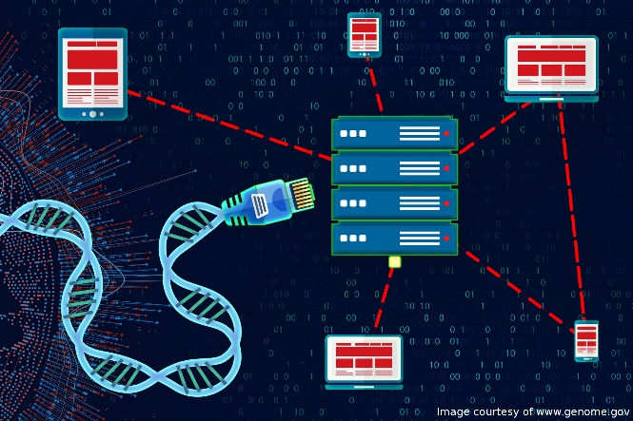
As informatician you have a lot of tasks,
Algorithms
Databases and information system
Web technologies
Artificial intelligence and soft computing.
Information and computation theory
Software engineering
Data mining
Image processing
Modelling and simulation

Slide 20
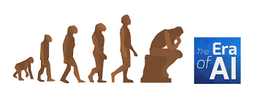
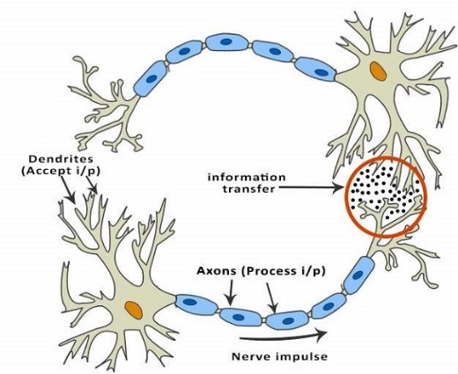
What do Bioinformaticians do?
DNA computing
Neural computing
Evolutionary computing
Cellular computing

Slide 21
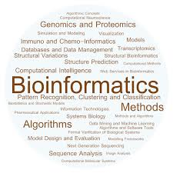
Skills Needed
Database administration and programming skills
SQL, Oracle, Sybase, Cobra, Java, Web scripting
Skills for data analysis, storage and retrieval
Skills to do molecular modeling programs

Slide 22
What can we(Computer science students) do to improve this field?
Development and implementation of computer programs that enable efficient access to, management and use of, various types of information.
Development of new algorithms (mathematical formulas) and statistical measures that assess relationships among members of large data sets. For example, there are methods to locate a gene within a sequence, to predict protein structure and/or function, and to cluster protein sequences into families of related sequences.

Slide 23
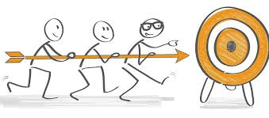
Goals
To uncover the wealth of Biological information hidden in the mass of sequence, structure, literature and biological data.
It is being used now and in the foreseeable future in the areas of molecular medicine.
It has environmental benefits in identifying waste and clean up bacteria.
In agriculture, it can be used to produce high yield, low maintenance crops.

Slide 24
SUMMARY
The primary goal of bioinformatics is to increase the understanding of biological processes.
Bioinformatics now entails the creation and advancement of databases, algorithms, computational and statistical techniques, and theory to solve formal and practical problems arising from the management and analysis of biological data.

Slide 25
SUMMARY
Bringing biological themes into computers.
It is used in research work such as drug development and genetic engineering .
Thus, “Bioinformatics is the name given to these mathematical and computing approaches used to glean understanding of biological processes”

Slide 26

Any Query?

Slide 27

Thanks for your attention and cooperation

